Slide 1
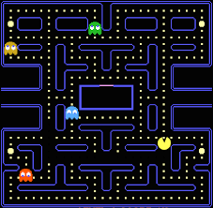
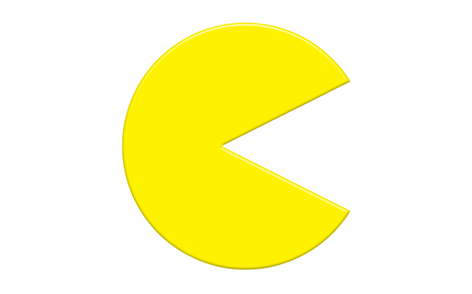
I am sure that some of you may know me. Are you prepared to create your own Pac Man game now? You can use Scratch to do it and enjoy yourself.

Slide 2
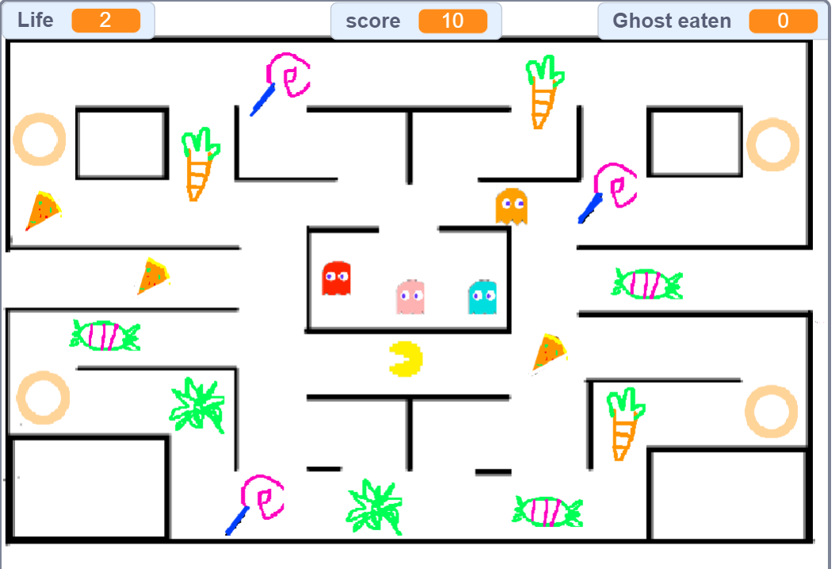
Let's play Pac Man and try to score more points while avoiding ghosts.

Slide 3

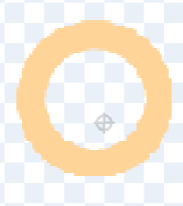
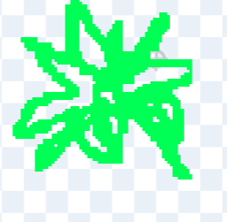
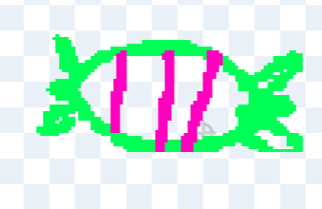
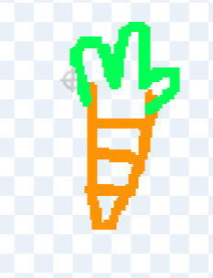
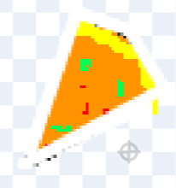
How can we create the game ?
Open a new project in visual coding.
Add sprites: it's time to start drawing sprites. Our sprites will include the Pacman, all of the below sprites.Go to Choose a Sprite and select the paint & add all the sprites to your project.

Slide 4
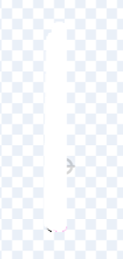
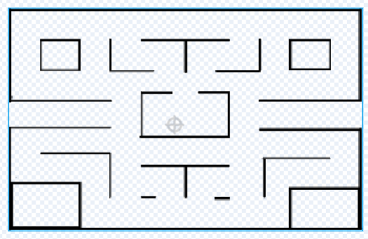

Slide 5



Add sprites: Go to Choose a Sprite and select the upload sprite in the
below link
https://drive.google.com/file/d/1OqvwEnr5YoXLr5hGUOf2310KQ858EA8p/view?usp=sharing

Slide 6
Variables
We use containers to keep things, like we keep our book in a bag, milk in a bottle etc.
Computers need to store values like we memorize names of our friends, place we kept the toys etc.
Computers use Variables to store(memorize) data.
Variables are containers to store values.

Slide 7
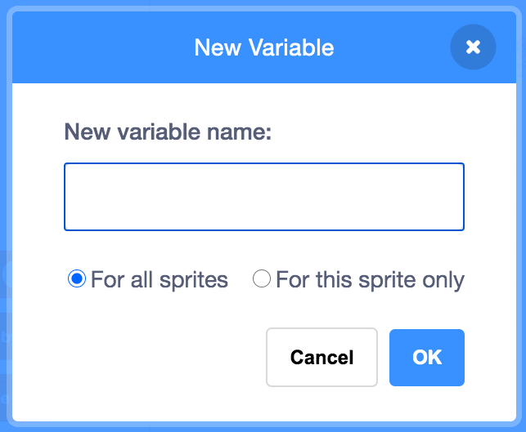

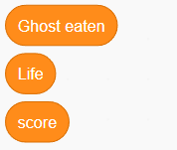
Creating a variable
You can create a variable by clicking on Make a Variable button in Variables palette.
Enter the name of the variable and click on OK button to create the variable.

Slide 8
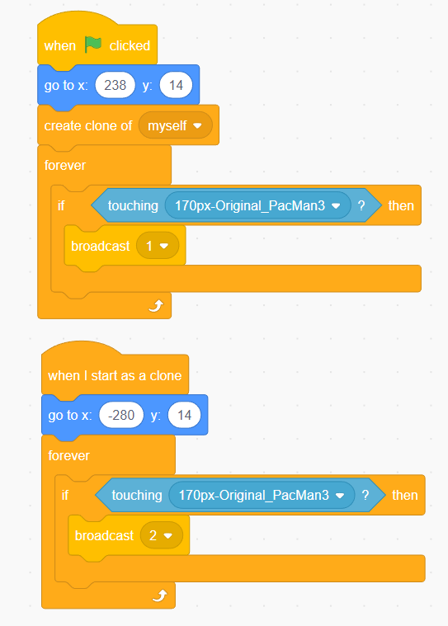
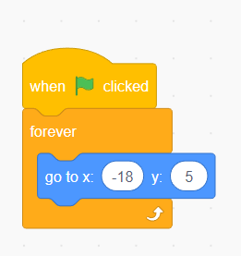

Slide 9
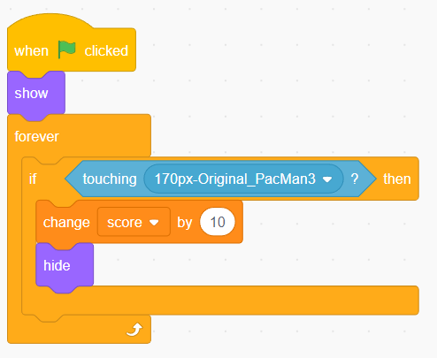
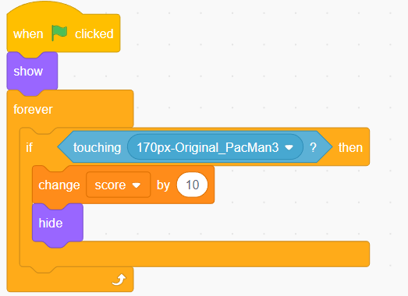

Slide 10
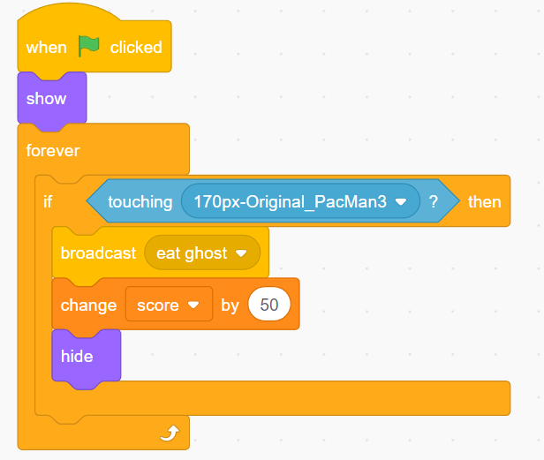
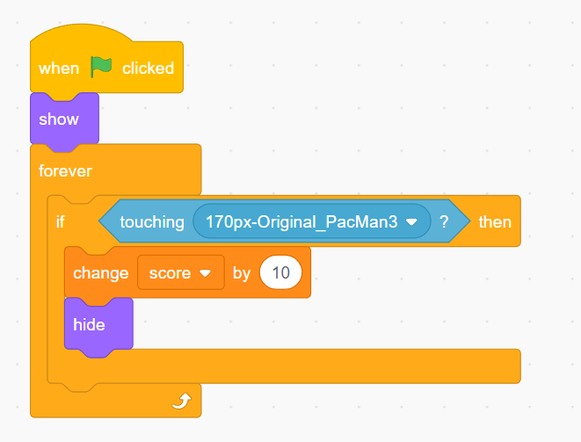

Slide 11
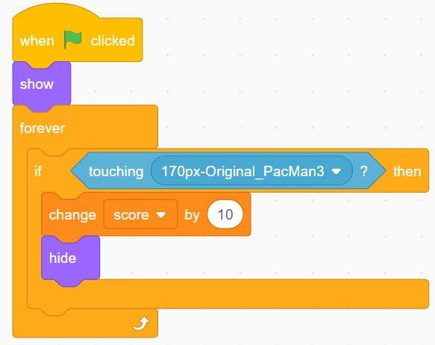

Slide 12
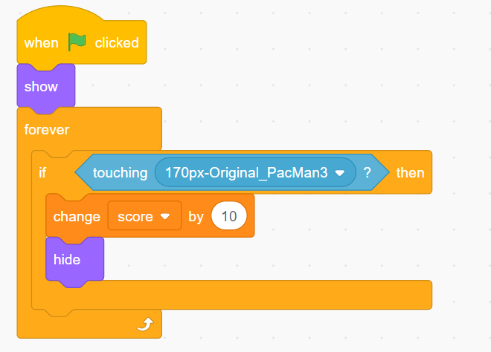

Slide 13
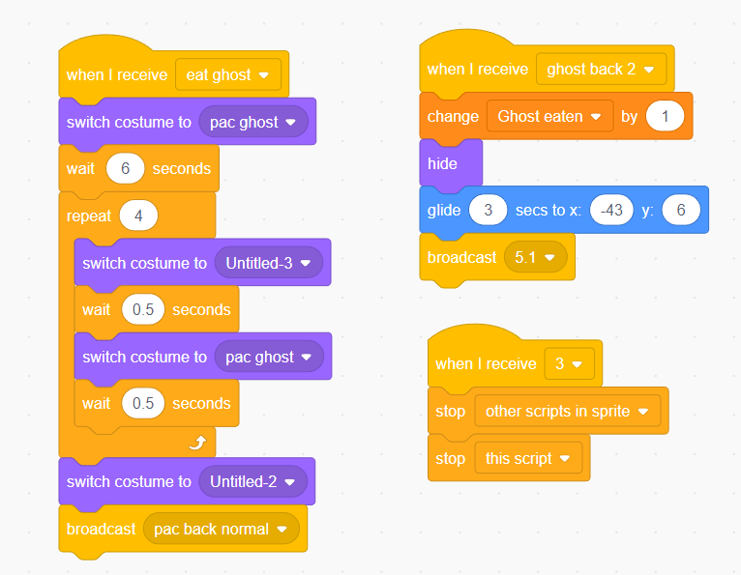

Slide 14
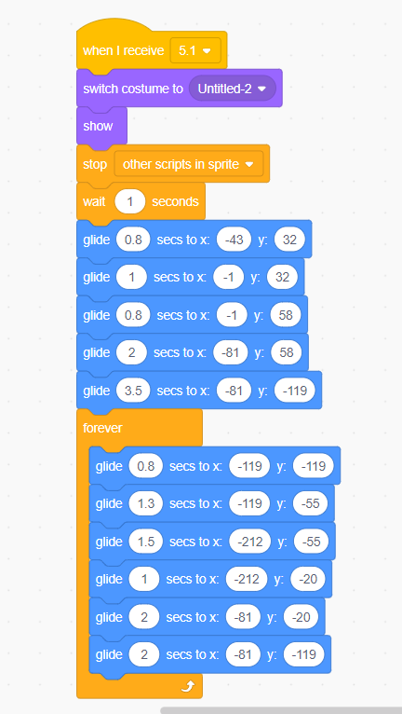
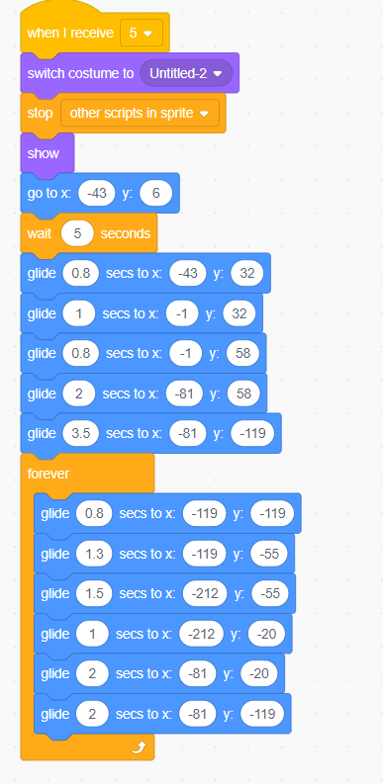

Slide 15
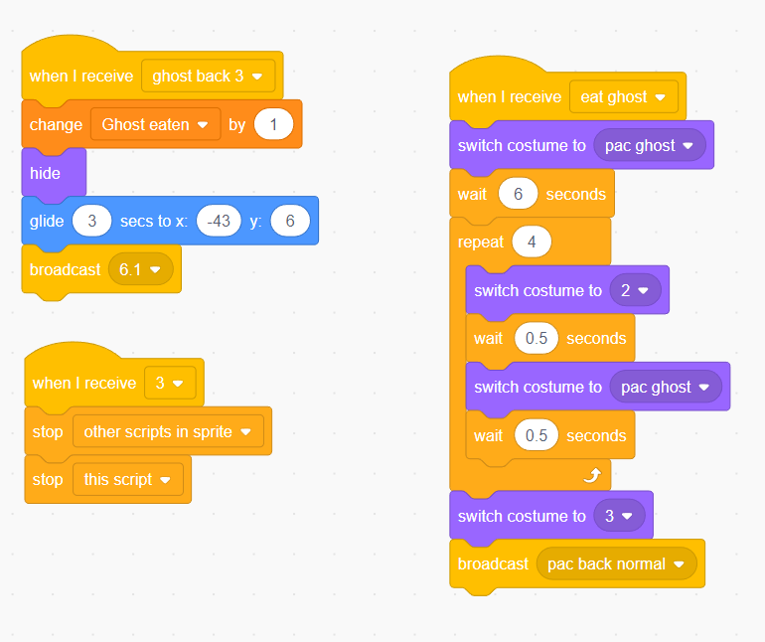

Slide 16
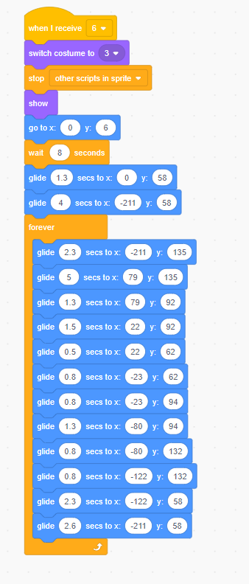
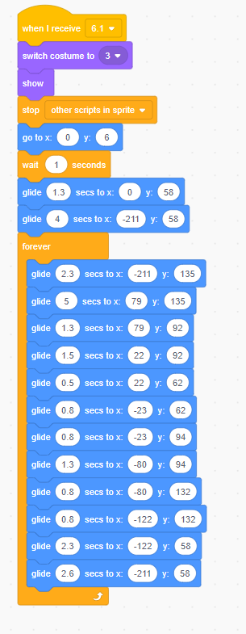

Slide 17
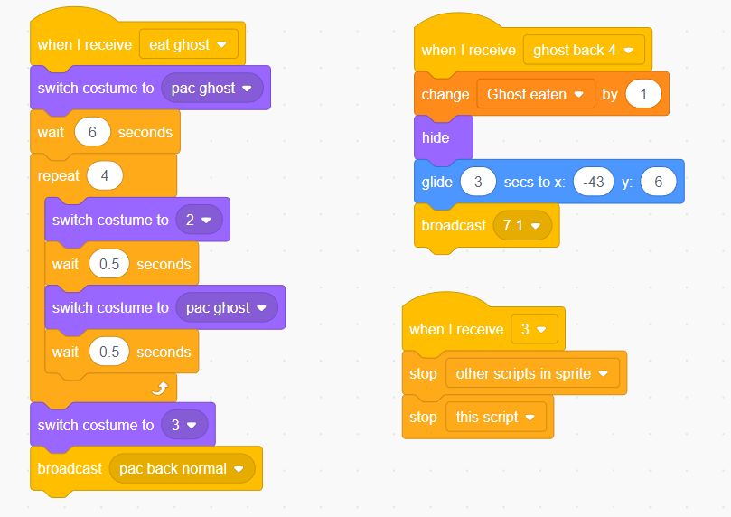

Slide 18
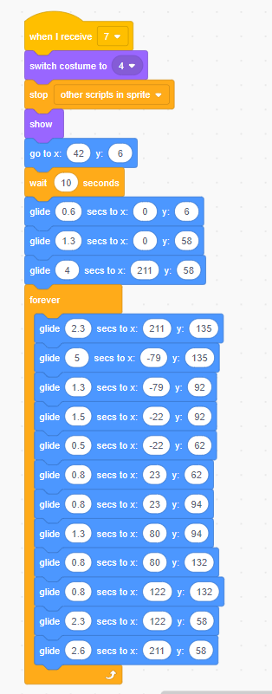
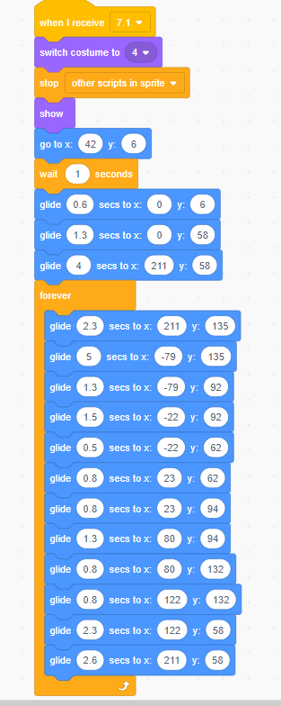

Slide 19
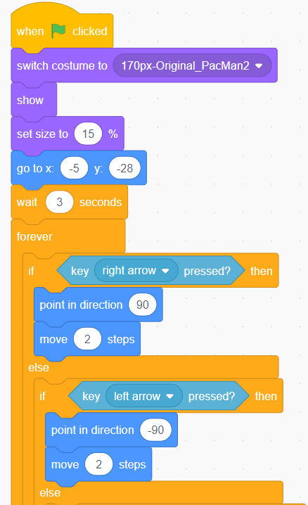
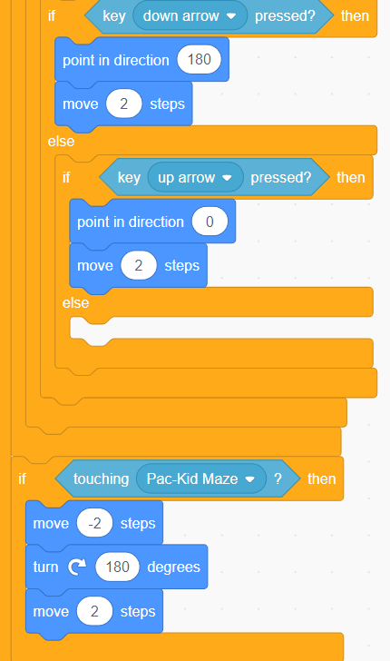

Slide 20
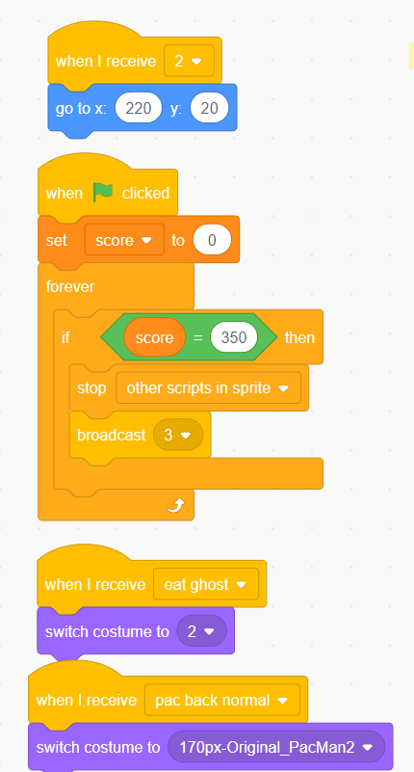
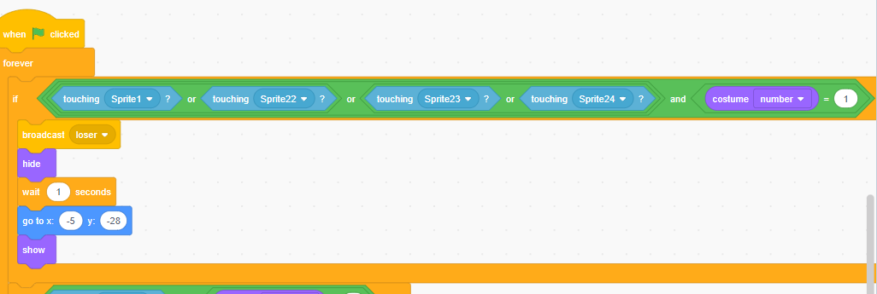
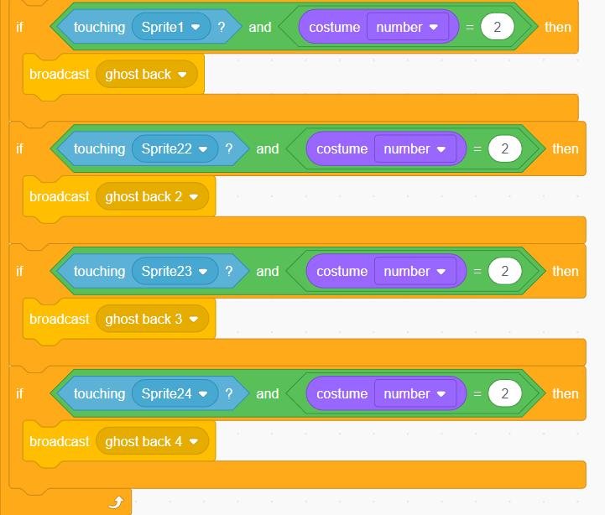

Slide 21
Thankyou

